Slide 1
Directional Analytics for Day Trading in Stock Market
REVA Academy for Corporate Excellence (RACE)
Anand Mohan
SRN: R19MBA53
Date: 10/10/2022
MBA in Business Analytics
Capstone Project Presentation
Year: II
race.reva.edu.in

Slide 2
Agenda
01
09
Descriptive Analytics
Introduction
05
Project Methodology
Conceptual Framework | Research Design
Univariate | Bivariate | Hypothesis
Back Ground | Current status | Why this study
10
Modeling
02
06
Literature Review
Business Understanding
Machine Learning | Model Evaluation | Insights
Seminal works | Summary | Research Gap
Business Context | Monetary Impact
11
Model Deployment
03
07
Data Understanding
Applications | Demo
Problem Statement
Business Problem | Analytics Solution
Data Collection | Variables
12
Suggestions and Conclusions
Insights | Next Step \| Future Scope
04
08
Data Preparation
Project Objectives
Primary & Secondary Objectives | Expected Outcome
Pre-processing | Process \| Techniques
13
Annexure
References | Publications | Plagiarism Score

Slide 3

Introduction
Background | Current status | Why this study
Algorithmic Trading
Back testing
Stock Market-high volatility-New field for Researchers!
ML, AML, Deep Learning Algorithms .
Higher Accuracy.
Minimize Errors.
ML Algorithms rank on relative expected outcome.

Slide 4
Literature Review
Paper Title | Authors | Journal | Objective | Research Gap (if any)
Forecasting stock market prices : A machine learning approach | Alhomadi, Abraham | Digital Commons | predict SM Ret using ML | ML failed to predict returns with high accuracy.
Stock market analysis: A review and taxonomy of prediction techniques | Shah, Dev Isah, Haruna Zulkernine, Farhana | Inter national Journal of Financial Studies | Ml +other Techniques for analysis, forecasting in SM. | More Hybrid approaches needed- Statistical+ MLTechniques
Proceedings of the 25th {ACM} {SIGKDD} International Conference on Knowledge Discovery & Data Mining, {KDD} 2019, Anchorage, AK, USA, August 4-8, 2019 | Vreeken, Jilles Yamanishi, Kenji | Conference | opensource AutoML system based on Auto-Keras. | None

Slide 5
Literature Review
Seminal works | Summary | Research Gap
Paper Title | Authors | Journal | Objective | Research Gap (if any)
Stock Market Prediction: A Survey and Evaluation | Biswas, Milon Nova, Arafat Jahan Mahbub, Md Kawsher Chaki, Sudipto Ahmed, Shamim Islam, Md Ashraful | 2021 International Conference on Science and Contemporary Technologies, ICSCT 2021 | Examine models and approaches for stock market prediction highlighting their pros and shortcomings. | study on the dependability and compliance aspects of the stock market ids missing.
Principal components analysis | López del Val, J. A. Alonso Pérez de Agreda, J. P. | Atencion primaria / Sociedad Española de Medicina de Familia y Comunitaria | Extract important information from the statistical data to represent it as a set of new orthogonal variables i.e.principal components. | None

Slide 6

Problem Statement
Business Problem | Analytics Solution
Easy, and simple Modelling techniques
Minimize losses
Fundamental Analysis-
Long Term Investments
Technical Analysis-trends in the stock's price, momentum, and volume
Algorithmic trading
Volatility Still Unpredictable

Slide 7


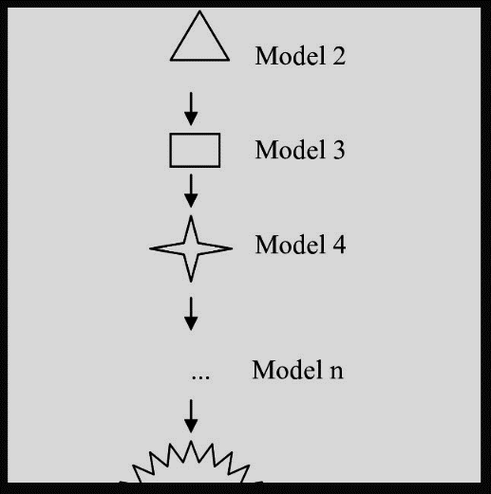
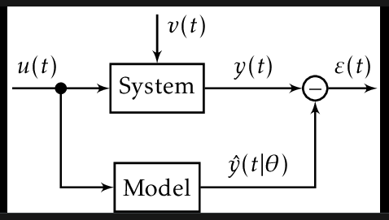

Project Objectives
EDA
Hypothesis Testing
Feature Addition
Get Right Stock
Collect Relevant data
Minimize prediction errors.
standard Error Metrics
MAE, MSE,RMSE,MAPE,
Median Absolute Error
simple models-linear regression, Decision tree
Advanced ML
Deep Learning

Slide 8
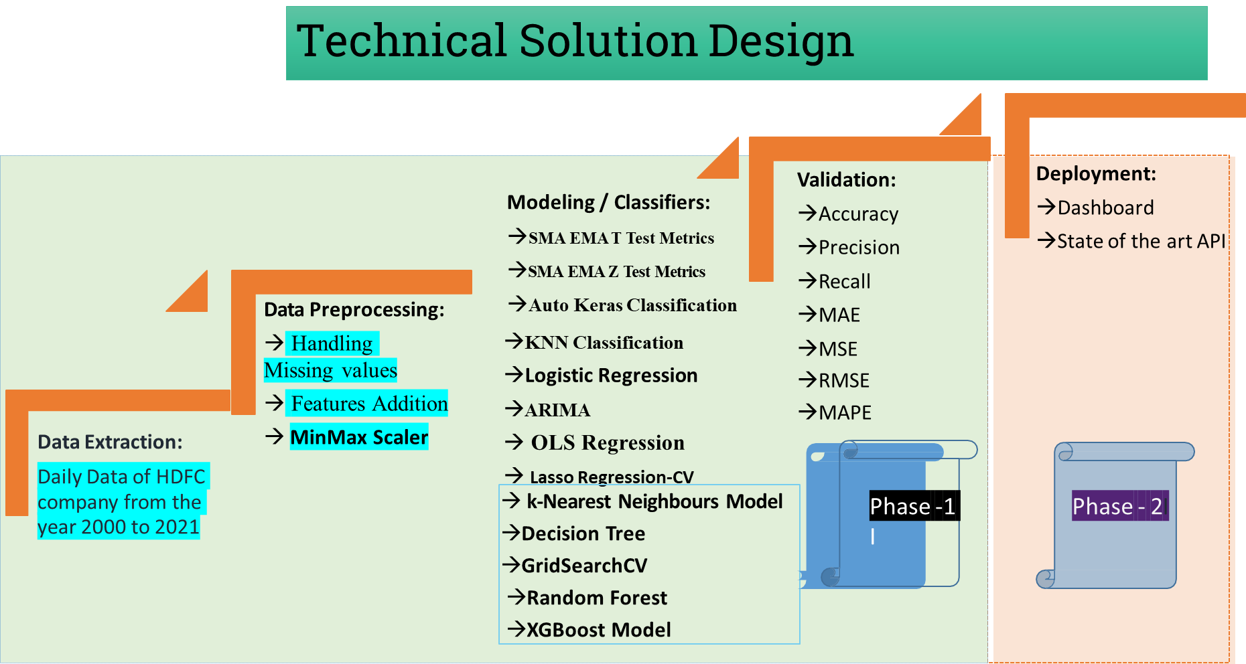
Project Methodology

Slide 9
Business Understanding
HDFC Stock Technical Analysis
HDFC Stock Fundamental Analysis
RSI-57.53
RSI is indicating that HDFC stock is moving in an upward trend.
1305
Fifty-two weeks high for HDFC bank shares.
Moving Average Convergence Divergence is indicating that HDFC stock is showing an upward trend.
MACD - 34.09
4.98 Trillion
Market capitalization value of more than $10 billion making it a Large Cap company.
Caution: HDFC stock is overbought and hence the investor should wait for some time so that the Stochastic indicator gives a lesser value.
Stochastic- 86.62
The revenue has been increasing in the last decade.
CAGR-20%
HDFC stock ADX is quite higher meaning it will show a very intense upward or downward trend.
ADX- 41.95

Slide 10
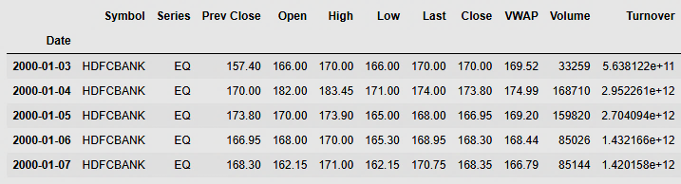
Data Understanding
The previous close nearly always refers to the previous day's final price.
The opening price is the first trade price that was recorded.
The high is the highest price at that a stock is listed during a period.
The low is the lowest price of the period
The last price is the one at which the foremost recent transaction happens.
The close is the last price once the market is closed on the day.
volume-weighted average worth (VWAP) represents the typical price listed throughout the day, based on both volume and worth.
Volume and Share turnover is an estimation of stock liquidity.

Slide 11



Data Preparation
'Trades', 'Deliverable Volume', and'% Deliverable' had more than 100 missing values. Hence, those columns were dropped.
13 days,20 days,100 days, 200 days Simple moving averages were added in the data frame. conjointly enclosed were exponential moving averages for 7 days,13 days,20 days,100 days, and 200 days.1 day's previous lag values of volume is also added in as derived features.
MinMax Scaler shrinks the data inside the given range in this project i.e. from zero to one. It scales the price to a selected value range while not varying the form of the initial distribution.

Slide 12
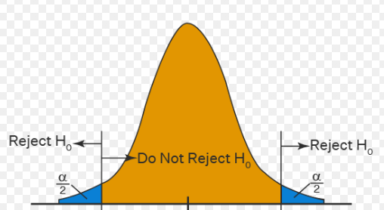
Descriptive Analytics
Hypothesis testing using 7-day, 13-day, 20-day, 100-day, and 200-day moving averages.
It is to be determined how frequently the price rise predicted by the hypothesis testing is the same as the actual price rise for the next day.
Hypothesis Testing

Slide 13
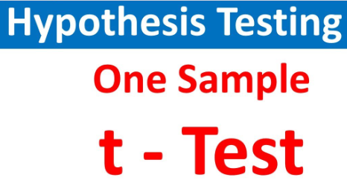




Modeling
Modeling Techniques | Modeling Process | Model Building
T Test based on Hypothesis Testing for Simple Moving Averages of 7 days,13days, and 20 days and Exponential moving Averages of 7 days,13days, and 20 days.
Z Test based on Hypothesis Testing Metrics for Simple Moving Averages of 100 days and 200 days and Exponential moving Averages of 100 days and 200days.
Auto Keras Classification Model , KNN Classification Model, and Logistic Regression
Simple Moving Averages of 7-days,13-days,20-days and100-days and Exponential moving Averages with 200 days span is used as Target Variables to recreate 5 different Auto Arima Models.
OLS, Lasso, CVLASSO, KNN, Decision Tree, GridSearchCV, Random Forest, XGBoost, PCA with LSTM, PCA with LSTM with Moving Average variables, LSTM Neural Network, and AutoKeras.

Slide 14
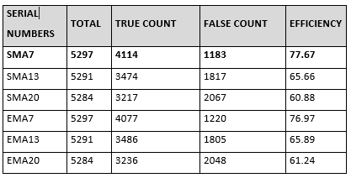
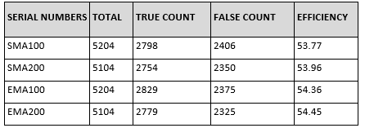
Model Evaluation
Results | Interpretation | Insights
Highest Efficiency=>
T-test Hypothesis testing for 7-days SMA
Z Test based on Hypothesis Testing=>Efficiency not satisfactory

Slide 15
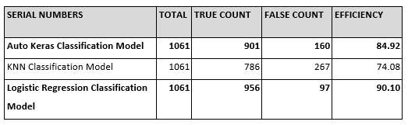
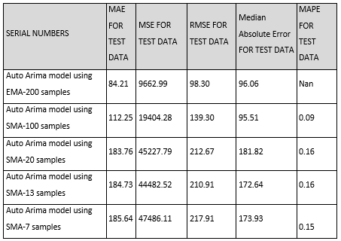
Model Evaluation
Results | Interpretation | Insights
Highest Accuracy=>
Logistic Regression Classification Model closely followed by Auto Keras classification Model
Dataset under consideration not suitable for ARIMA Modelling algorithm.

Slide 16
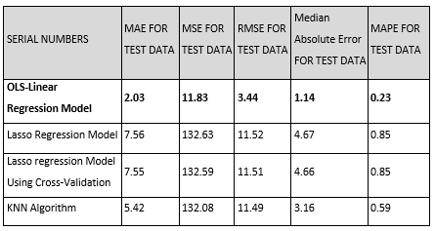
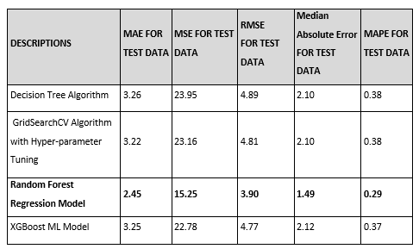
Model Evaluation
Results | Interpretation | Insights
Model exhibiting Satisfactory MAE and MAPE=>OLS-Linear Regression Model.
Model exhibiting Satisfactory MAE and MAPE =>Random Forest Regression Model.

Slide 17
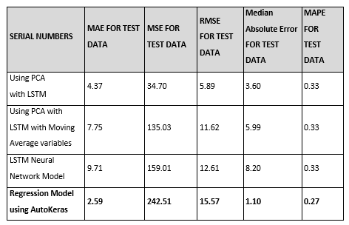
Model Evaluation
Results | Interpretation | Insights
Model exhibiting Satisfactory MAE and MAPE=>Using PCA with LSTM and Regression Model using Auto Keras.

Slide 18

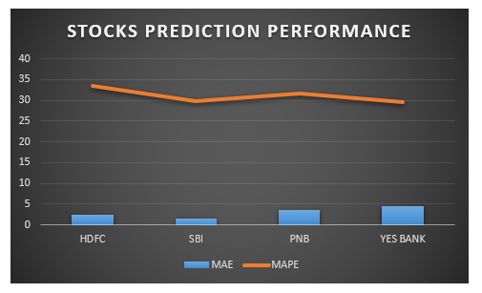
Model Deployment
Demonstration
As per the proposal for future assignments, the dashboard takes API as an input Derived from the machine/deep learning algorithms for multi-label features with an end-to-end UI Interface.

Slide 19
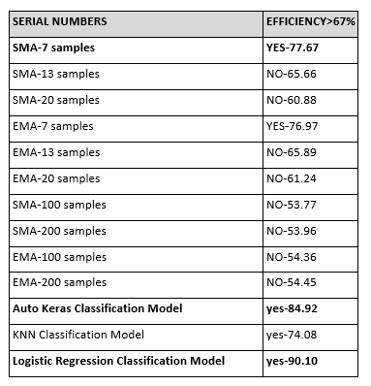
Results and Insights
Key Findings | Suggestions
RECOMMENDATION FROM BUSINESS PERSPECTIVE for the HDFC Stock:
85-90%Accuracy in predicting direction of close price given by Logistic Regression Classification Model and Auto Keras classification.
77.7%.Accuracy=>SMA-7 Hypothesis testing

Slide 20
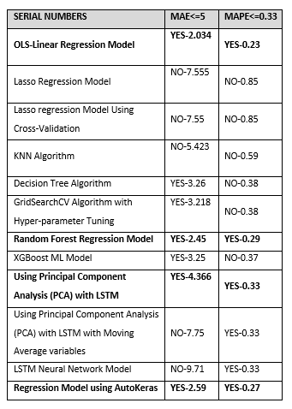
Results and Insights
Key Findings | Suggestions
RECOMMENDATION FROM BUSINESS PERSPECTIVE for the HDFC Stock:
Modelling Techniques with MAE<=5 and MAPE<=0.33 were:
OLS-Linear Regression Model, Random Forest Regression Model, Using PCA with LSTM, and Regression Model using AutoKeras.

Slide 21

Conclusion and Future Work
What works in the Indian stock market must be proven with evidence.
Any stock on the stock market can utilize the same procedure as defined in this project to forecast buy or sell choices, which is helpful.
It is assumed that returns are more or less constant over time. However, Returns are highly dependent on time. In future projects, it can be shown how to define Bullish and Bearish regimes using modern machine learning techniques.
The Sentiment Analysis Approach may also be explored using Text Analytics for predicting stock market returns.

Slide 22
References
Bibliography | Webliography
Aaron Patrick. (2020). HDFC Bank Fundamental Analysis and Future Outlook. https://billiondollarvaluation.com/hdfc-bank-fundamental-analysis-and-future-outlook/
Alhomadi, A. (2021). Forecasting stock market prices : A machine learning approach. Digital Commons, 11(2), 16–36.
Biswas, M., Nova, A. J., Mahbub, M. K., Chaki, S., Ahmed, S., & Islam, M. A. (2021). Stock Market Prediction: A Survey and Evaluation. 2021 International Conference on Science and Contemporary Technologies, ICSCT 2021, December. https://doi.org/10.1109/ICSCT53883.2021.9642681
Cornellius Yudha Wijaya. (2021). CRISP-DM Methodology For Your First Data Science Project. https://towardsdatascience.com/crisp-dm-methodology-for-your-first-data-science-project-769f35e0346c
Huang, Y., Capretz, L. F., & Ho, D. (2021). Machine Learning for Stock Prediction Based on Fundamental Analysis. 2021 IEEE Symposium Series on Computational Intelligence, SSCI 2021 - Proceedings, 5. https://doi.org/10.1109/SSCI50451.2021.9660134
Jierula, A., Wang, S., & Oh, T. (2021). applied sciences Study on Accuracy Metrics for Evaluating the Predictions of Damage Locations in Deep Piles Using Artificial Neural Networks with Acoustic Emission Data.
López del Val, J. A., & Alonso Pérez de Agreda, J. P. (1993). Principal components analysis. Atencion Primaria / Sociedad Española de Medicina de Familia y Comunitaria, 12(6), 333–338. https://doi.org/10.5455/ijlr.20170415115235

Slide 23
References
Bibliography | Webliography
moneycontrol. (n.d.). HDFC Bank Ltd.TECHNICALS. https://www.moneycontrol.com/technical-analysis/hdfcbank/HDF01/weekly
Rouf, N., Malik, M. B., Arif, T., Sharma, S., Singh, S., Aich, S., & Kim, H. C. (2021). Stock market prediction using machine learning techniques: A decade survey on methodologies, recent developments, and future directions. Electronics (Switzerland), 10(21). https://doi.org/10.3390/electronics10212717
Series, I. (2021). Machine Learning Algorithms and Applications. In Machine Learning Algorithms and Applications (Vol. 7). https://doi.org/10.1002/9781119769262
Shah, D., Isah, H., & Zulkernine, F. (2019). Stock market analysis: A review and taxonomy of prediction techniques. International Journal of Financial Studies, 7(3). https://doi.org/10.3390/ijfs7020026
Sonkiya, P., Bajpai, V., & Bansal, A. (2021). Stock price prediction using BERT and GAN. 6. http://arxiv.org/abs/2107.09055
Vreeken, J., & Yamanishi, K. (2019). Proceedings of the 25th {ACM} {SIGKDD} International Conference on Knowledge Discovery & Data Mining, {KDD} 2019, Anchorage, AK, USA, August 4-8, 2019. 1946–1956. https://doi.org/10.1145/3292500
Сороко, Н. В. (2017). Масові Відкриті Європейські Он-Лайн Курси Для Вчителів (2017 Р.). Інформаційний Бюлетень№ 1. 801, 1–23.

Slide 24
Annexure
Additional Information | Plagiarism score

Slide 25
Annexure
Publications | Conferences
The implementation for the capstone project can be accessed at the link below:
https://github.com/Embedded-org/ACCOMPLISHMENTS/tree/master/RACE_CAPSTONE_PROJECT1

Slide 26


